Slide 1
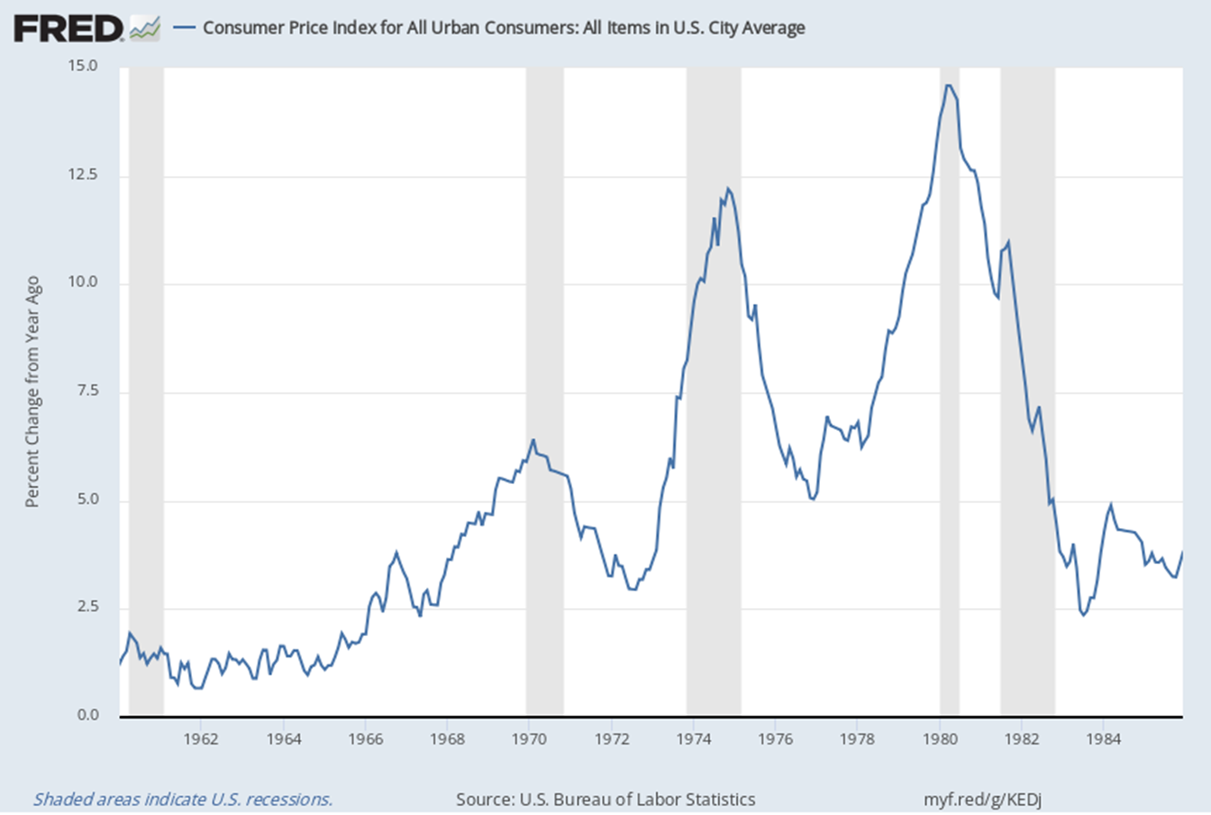
The Great Inflation

Slide 2
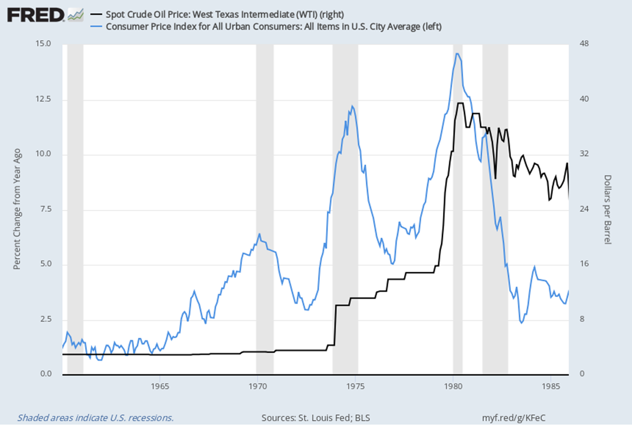
Great Inflation: Oil

Slide 3
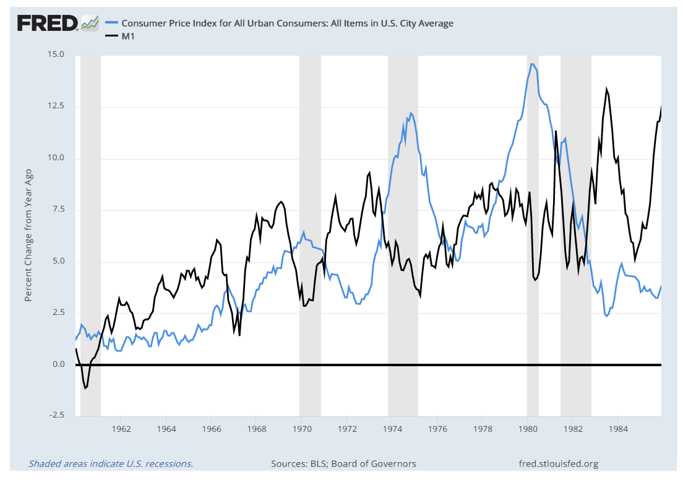
Great Inflation: Money Supply

Slide 4
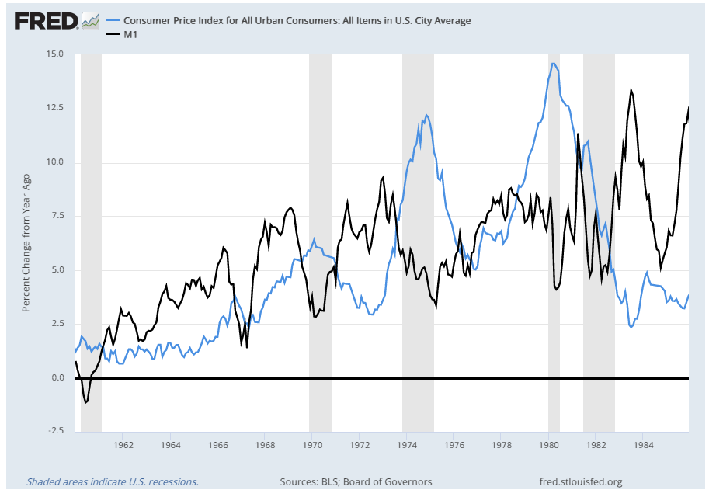
Great Inflation: Money Growth

Slide 5
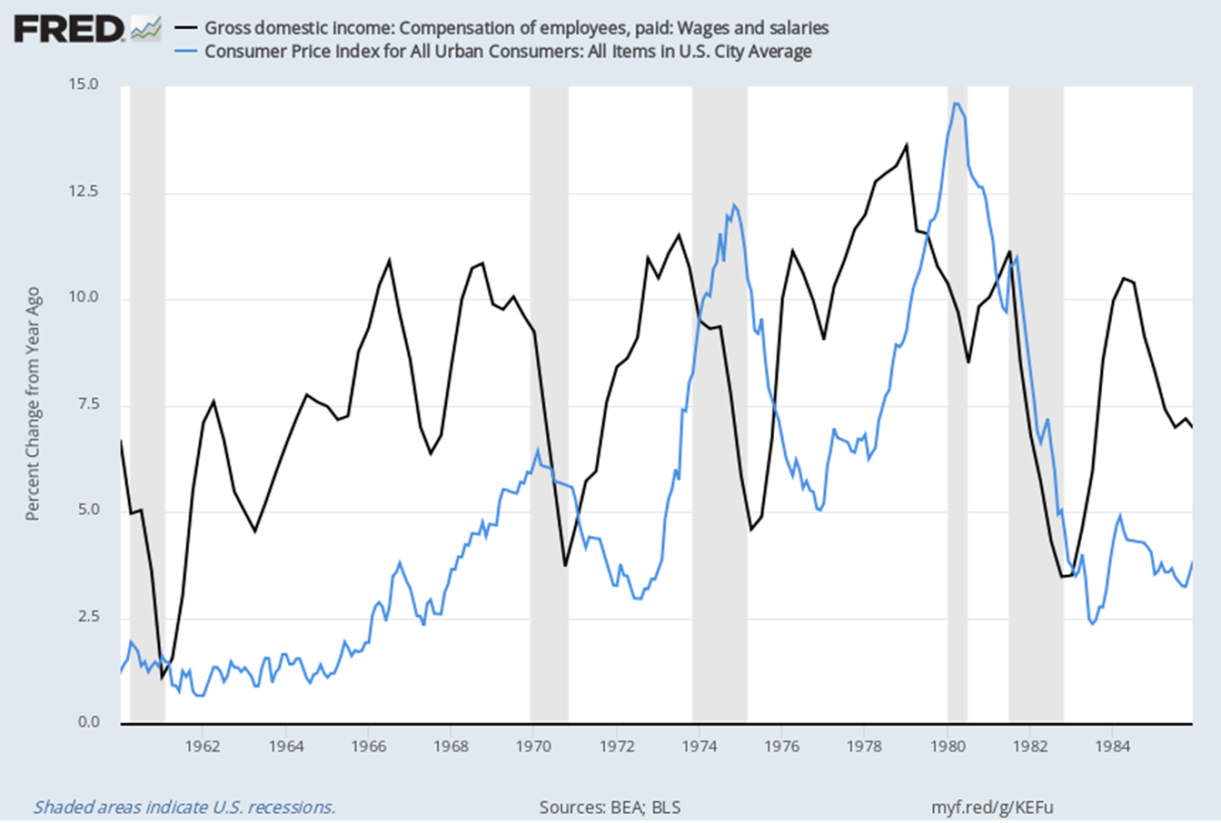
The Great Inflation: Wages

Slide 6
Inflation: Bottom Line
Inflation is a process. To become endemic and persistent, it must be accompanied by a factor or factors that keep it going.

Slide 7
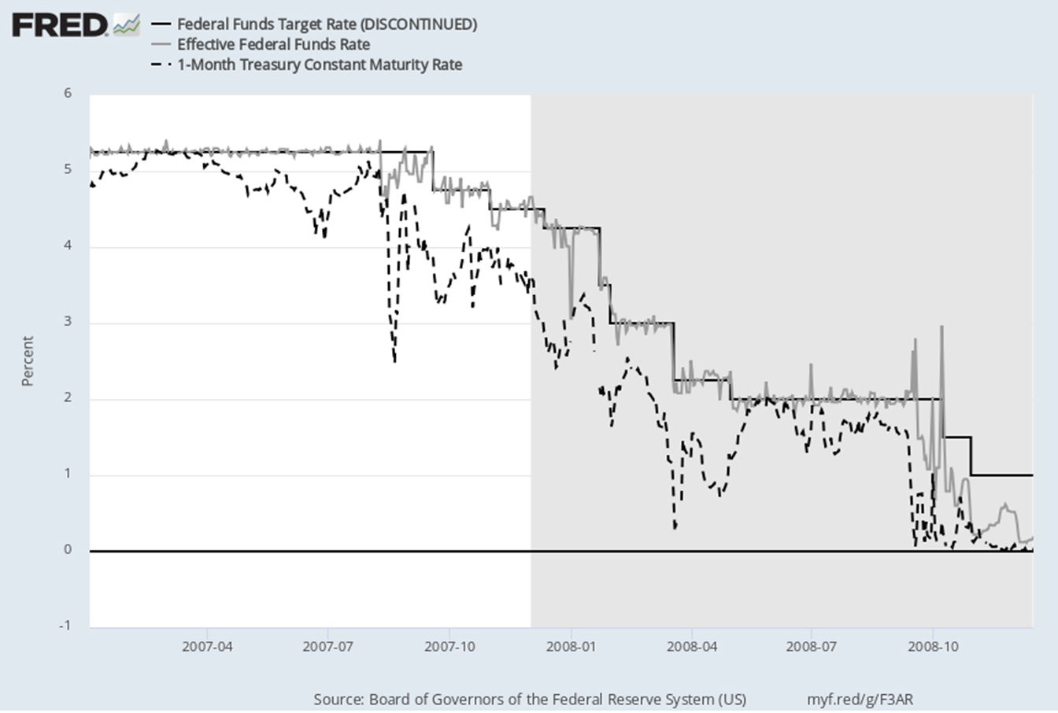
Financial Crisis: Policy Response
Aug. 9, 2007

Slide 8
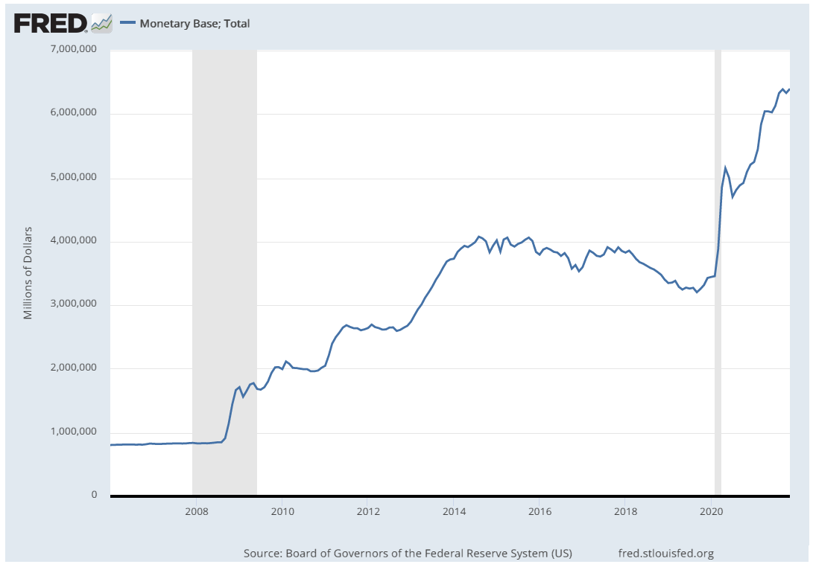
Post Lehman Monetary Policies
QE4
QE Ends
QE3
QE2
QE1

Slide 9
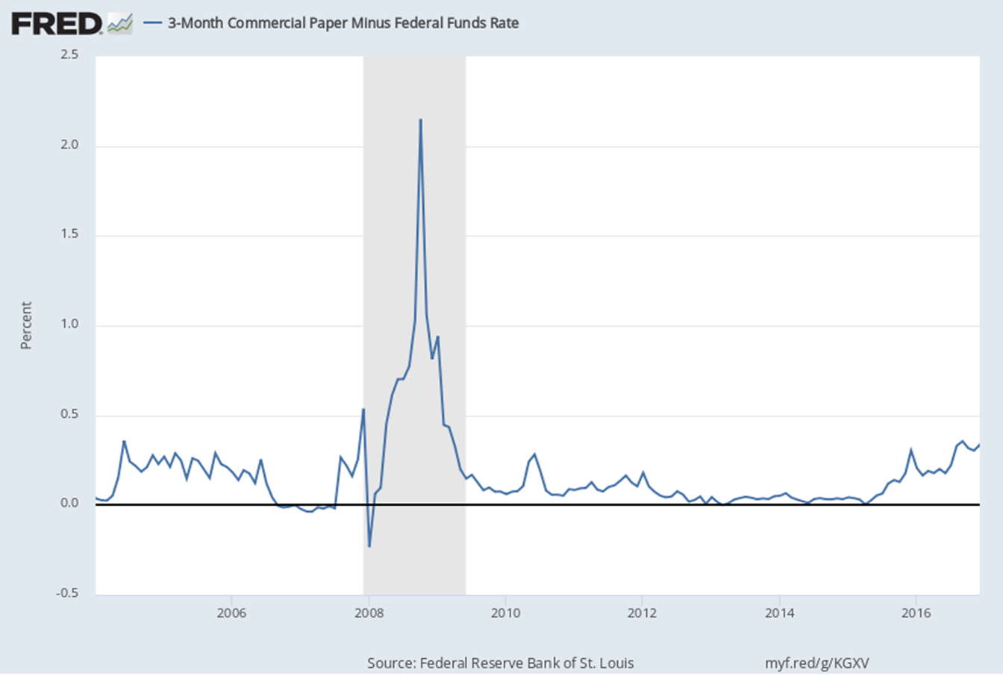
Credit Risk Spreads

Slide 10
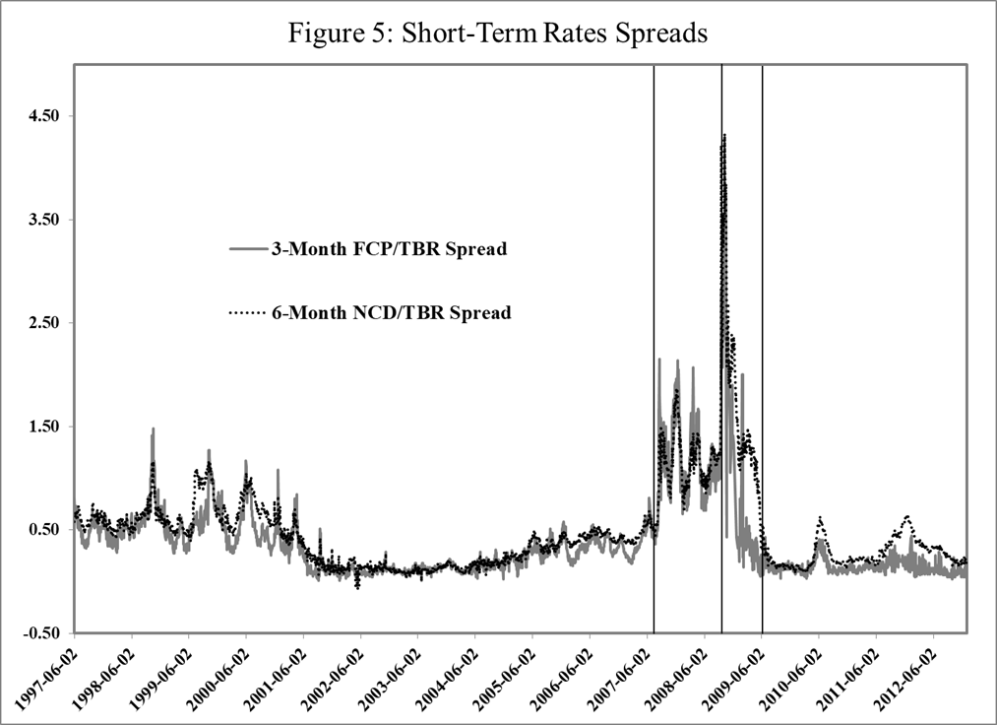
Credit Risk Spreads

Slide 11
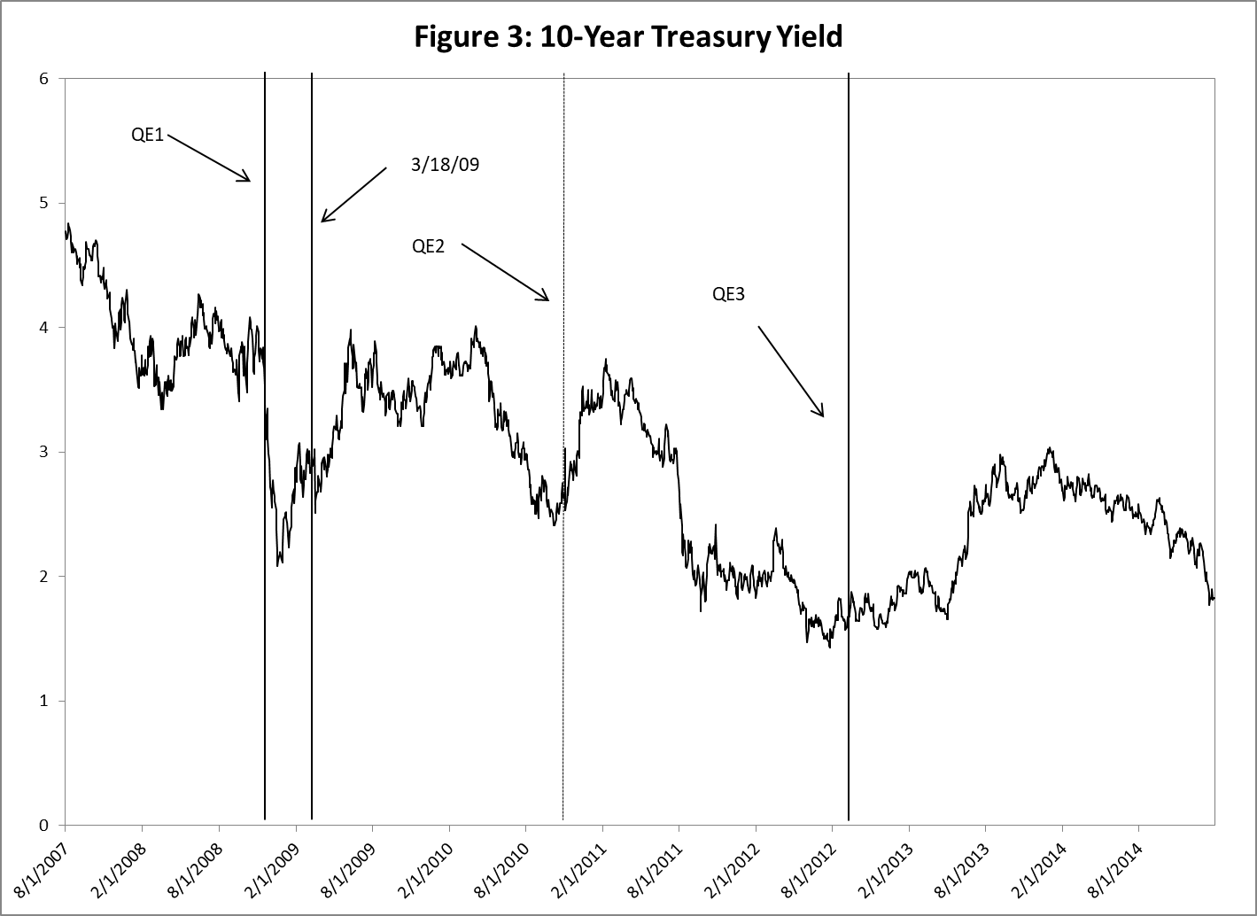
Effectiveness of QE

Slide 12
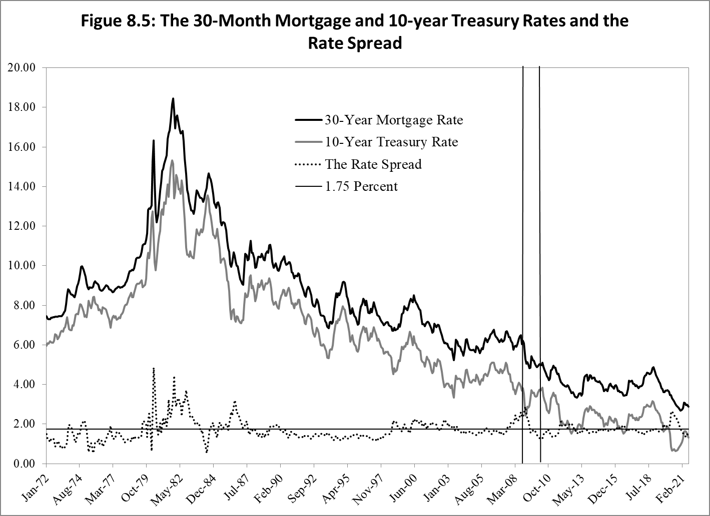
Effect of QE on Mortgage Rates

Slide 13
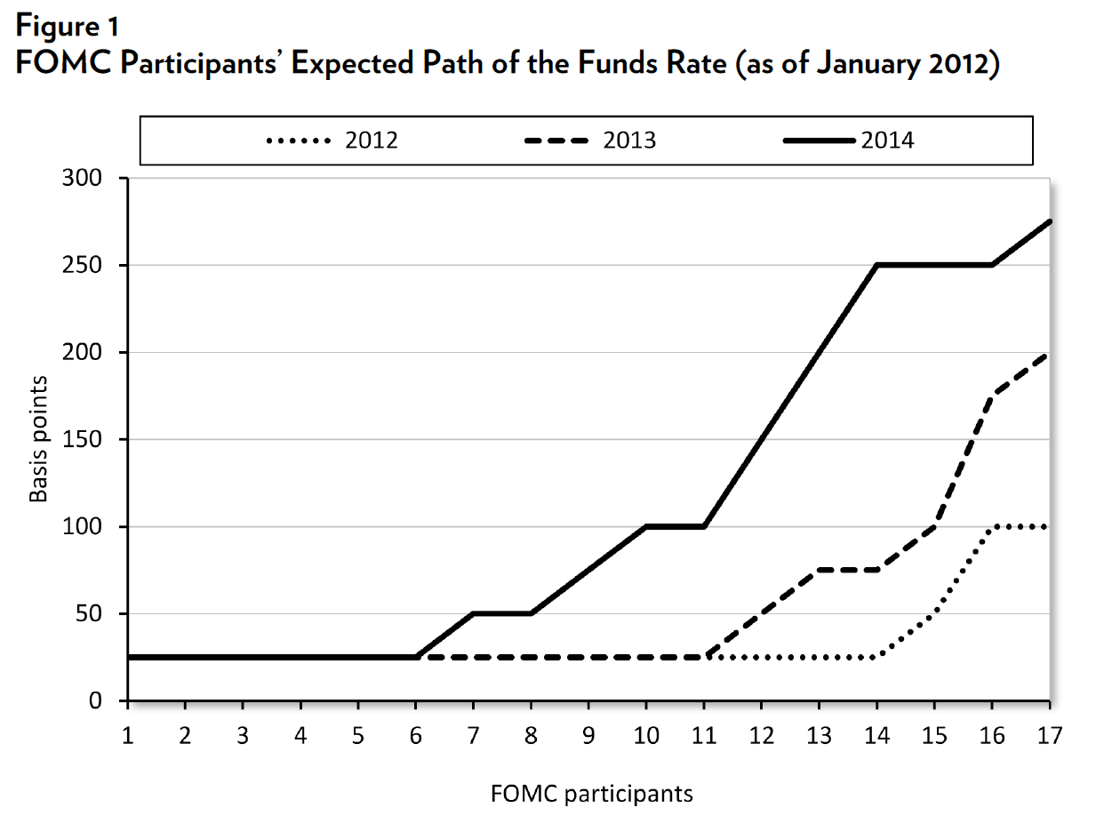
Response to Aug. 11 & Jan. 12 FG Announcements

Slide 14
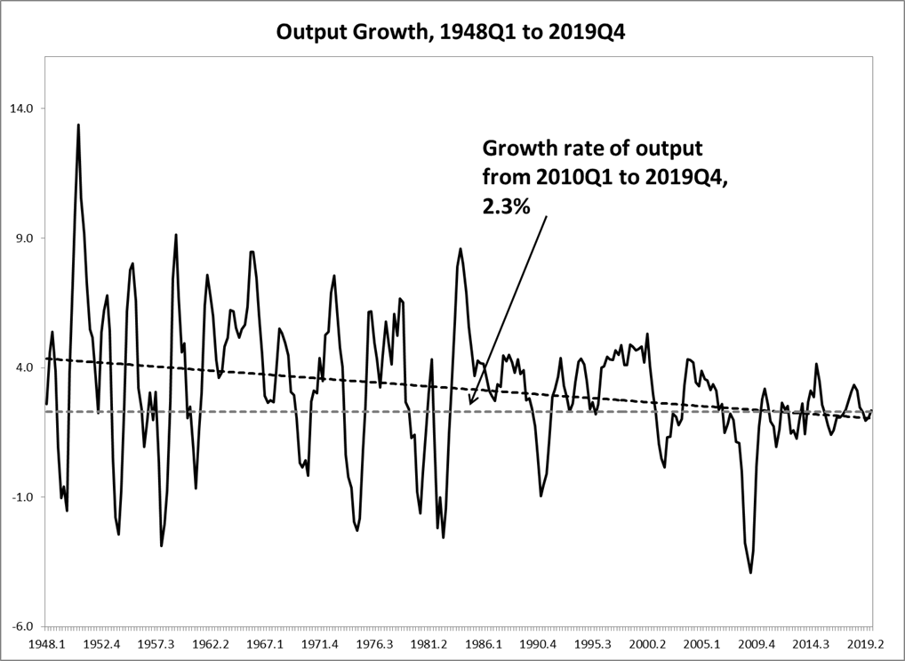
QE’s Effect on Economic Growth

Slide 15
Was QE Effective? You Decide
1. Inflation remained below the FOMC’s 2% target during this period.
2. The growth rate of output averaged 2.3% from January 2010 to December 2019.
3. The M2 money measure increased by $3.2 trillion from March 2009 to October 2014.
4. Output didn’t regain its pre-recession level until 2011Q3; the slowest of any post-war recession.
5. Employment reached it pre-recession level in May 2014; the slowest of any post-war recession.
6. The unemployment rate declined to its pre-recession level of 4.7 % on November 2016. A large portion of this decline was due to an historically large, and not fully explained, decline in the labor force participation rate

Slide 16
Pandemic Monetary Policy
The recession began in March 2020 and ended in April 2020.
The FOMC immediately reduced the funds rate target and began increasing its holdings of Treasuries, agency debt and MBS (residential and commercial) and for a short period state and local government bonds.
The Fed’s balance sheet has increased by more than $4.6 trillion so far.

Slide 17
Policies Effective? You Decide
1. Output is currently above it pre-recession peak.
2. Employment is still below its pre-recession peak.
3. The unemployment rate is 3.9%, but much of the decline in the unemployment rate is due to a very significant decline in the labor force participation rate, which is currently 2.5 percentage points below it pre-recession level.
4. The M2 money measure is $6.0 trillion above its pre-recession level.
5. The CPI inflation rate as of December 2021 was 5.5%.
6. The Fed’s balance sheet increased by $4.5 trillion since mid-March 2020.
7. The Fed currently holds 26.5% of the marketable Treasury debt.
8. The Fed currently holds about 20% of the outstanding MBS.

Slide 18
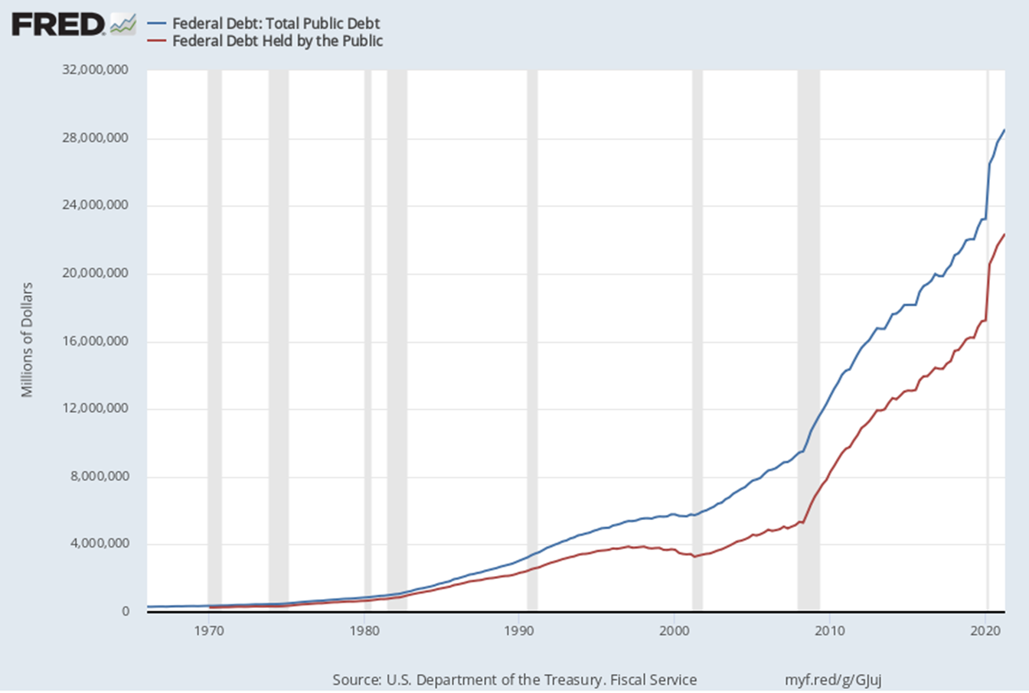
The National Debt

Slide 19
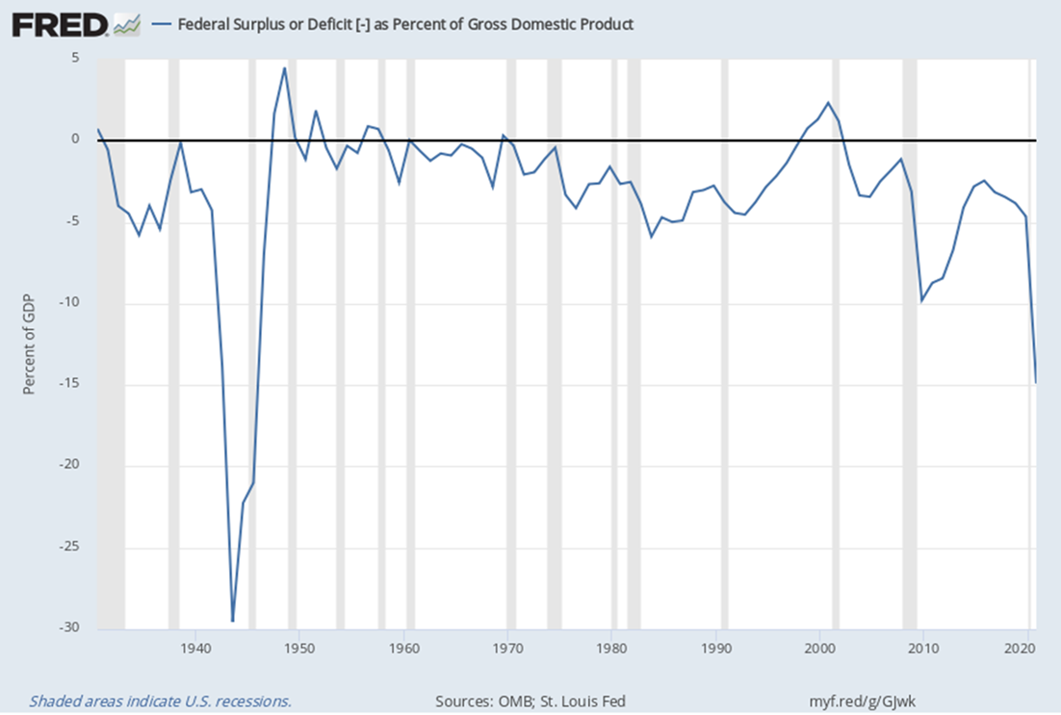
Surplus/Deficit as % of GDP

Slide 20
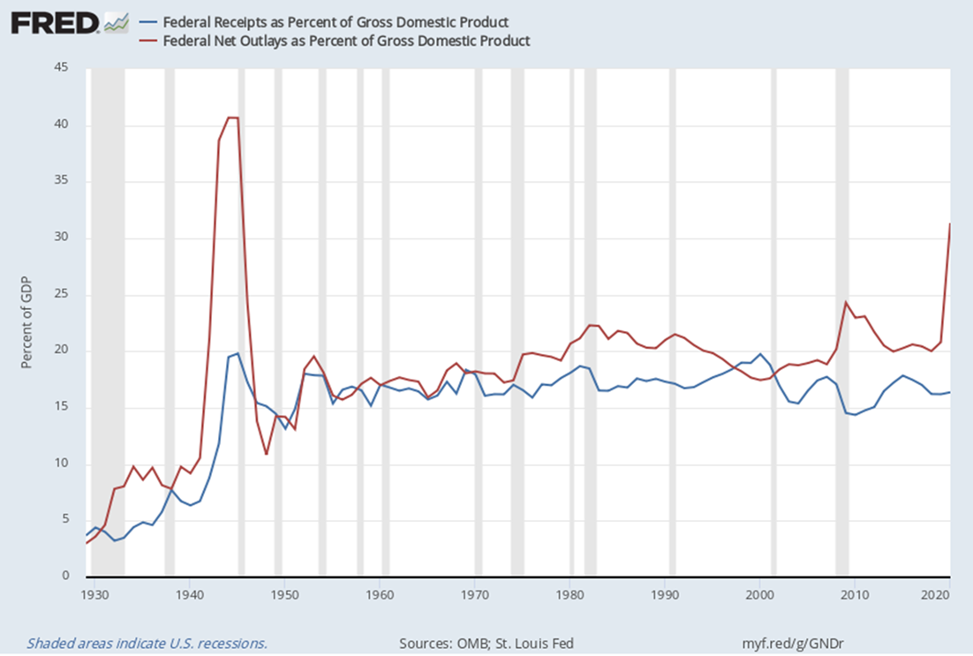
Federal Recipes and Outlays

Slide 21
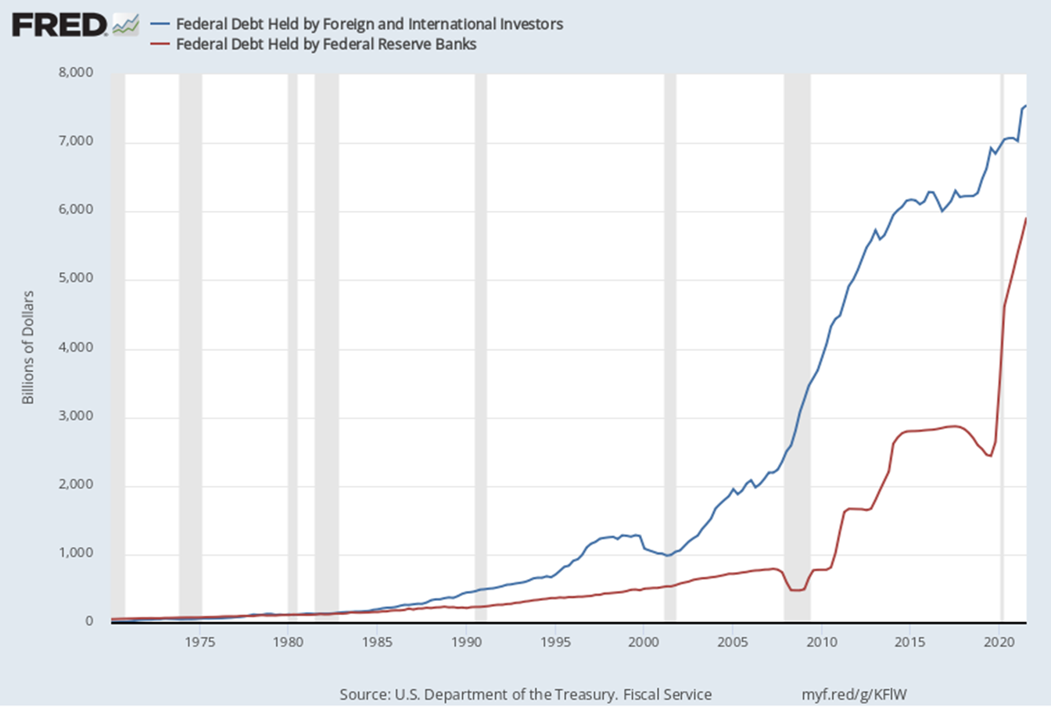
Debt Held by Fed & Foreigners

Slide 22
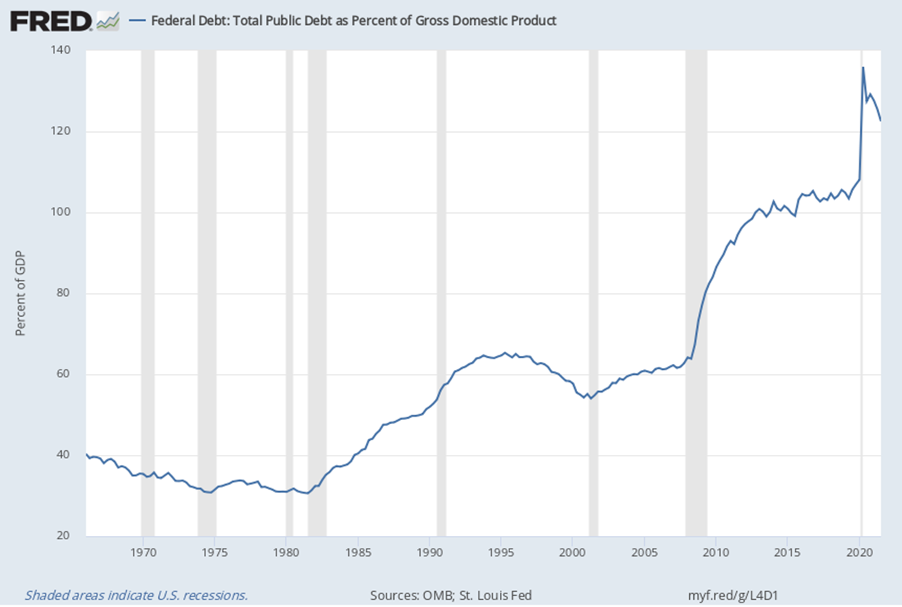
Public Debt as % of GDP

Slide 23
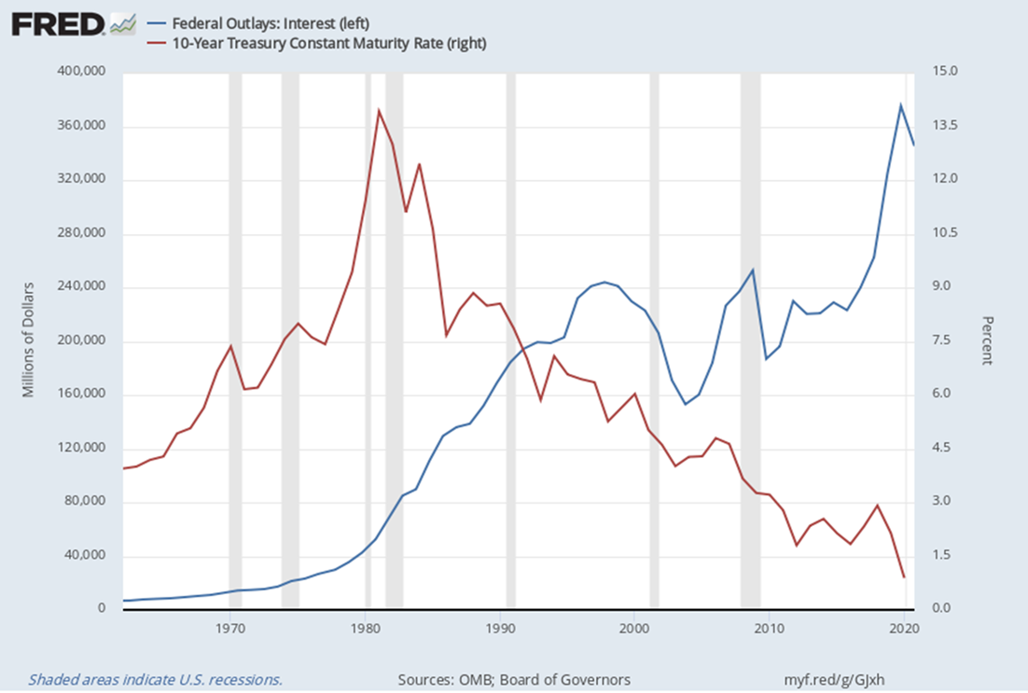
Debt Service & 10-Year Rate

Slide 24
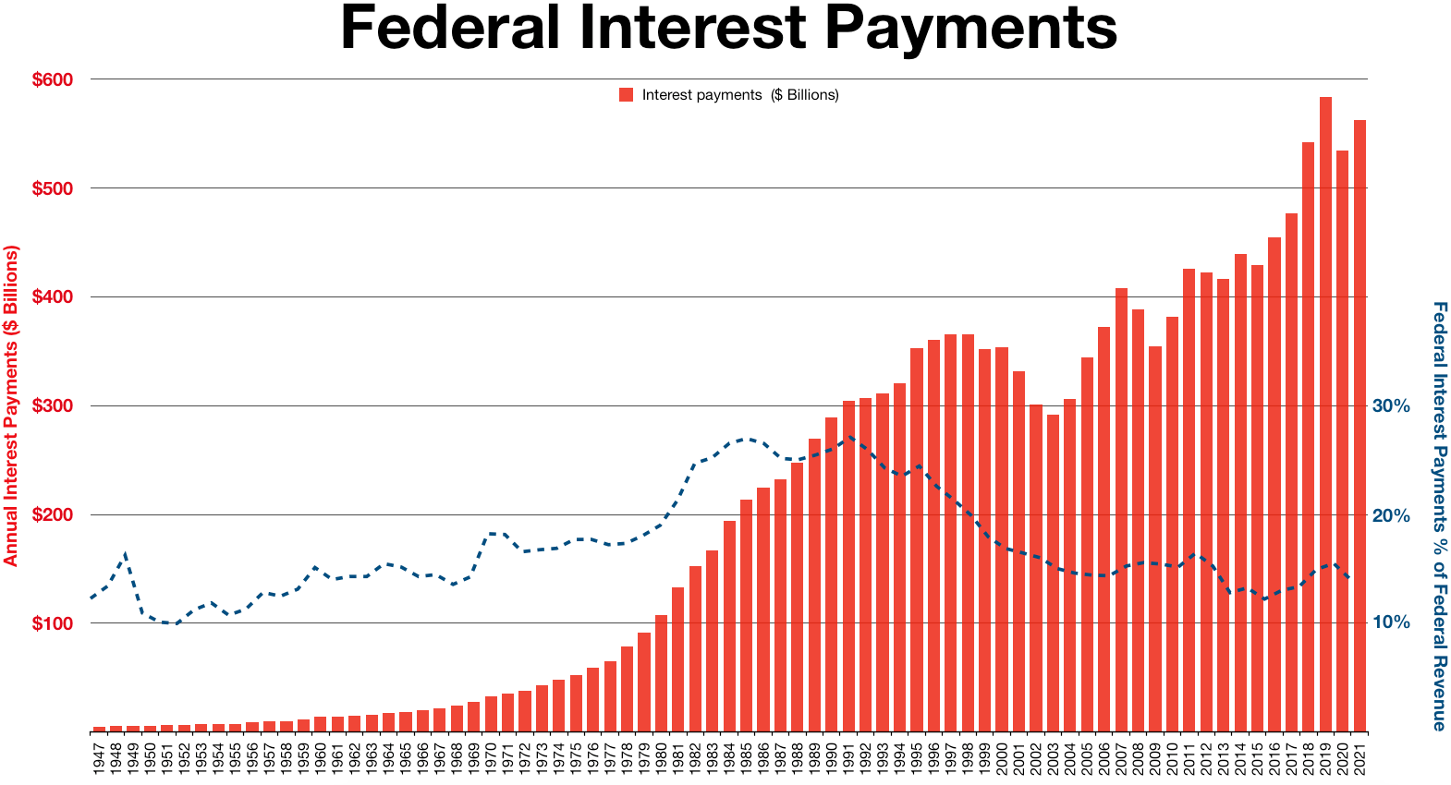
Interest Payments

Slide 25
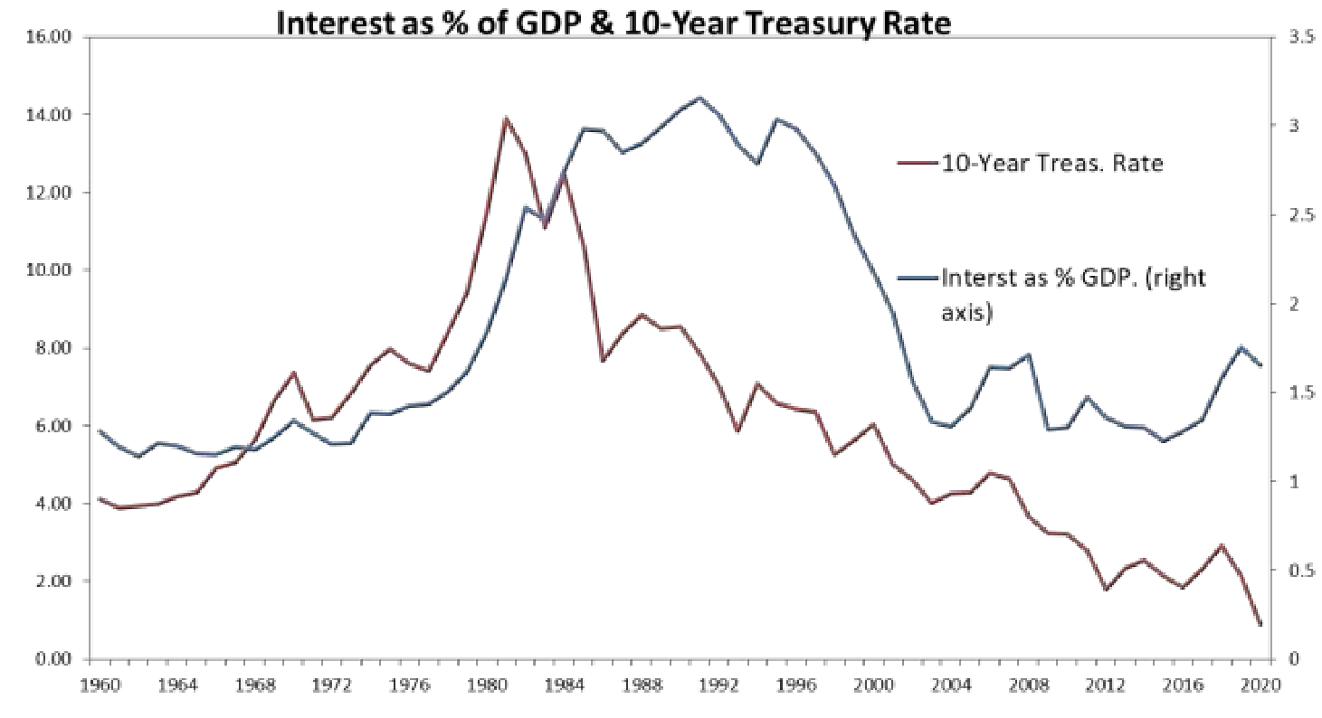
Interest as % of GDP

Slide 26
Debt Held by Fed & Foreigners

Slide 27
Is a U.S. Default Possible?
Is it likely
Probably not
But it is increasing becoming more likely.

